Slide 1


AI & ML: Transforming Technology Landscape
This presentation explores the transformative potential of Artificial Intelligence (AI) and Machine Learning (ML) across various sectors, from wearable technology to content creation and beyond.
by Adithya S.T.

Slide 2
The Rise of AI-Powered Computing
Advancements in Processing Power
Abundant Data Sets
Algorithms and Models
Vast amounts of data are now readily accessible, providing the fuel for AI algorithms to learn and evolve.
Sophisticated algorithms and models have been developed, enabling AI systems to perform increasingly complex tasks.
The increasing availability of powerful computing resources has fueled rapid progress in AI and ML.

Slide 3




Smart Glasses: The Next Frontier of Wearable AI
Augmented Reality (AR)
Computer Vision
Voice Recognition
Smart glasses offer immersive experiences by overlaying digital information onto the real world.
They leverage computer vision to recognize objects and environments, enabling applications like navigation and visual search.
Voice commands allow for hands-free interaction with smart glasses, making them convenient for various tasks.

Slide 4

Generative AI: Revolutionizing Content Creation
Text Generation
Image and Video Synthesis
AI models can generate realistic and engaging text, from articles and blog posts to scripts and creative writing.
AI can now create high-quality images and videos, revolutionizing content creation in various fields.
Music Composition
Generative AI algorithms are composing original music, pushing the boundaries of artistic expression.

Slide 5




Machine Learning Agents: Industry-Specific Solutions
Healthcare
Finance
Manufacturing
ML agents are assisting doctors in diagnosing diseases, analyzing medical images, and predicting patient outcomes.
AI-powered agents are used for fraud detection, risk assessment, and personalized financial advice.
ML agents are optimizing production processes, detecting defects, and improving efficiency in factories.

Slide 6

Multimodal Machine Learning: Beyond Single Data Types
Text
Traditional ML models often focus on processing text data.
Images
Multimodal ML expands to include images, allowing for more comprehensive understanding of data.
Audio
The integration of audio data enables AI to process information from various sources, such as speech and music.
Video
Multimodal ML embraces video data, creating opportunities for AI to analyze complex scenes and interactions.

Slide 7
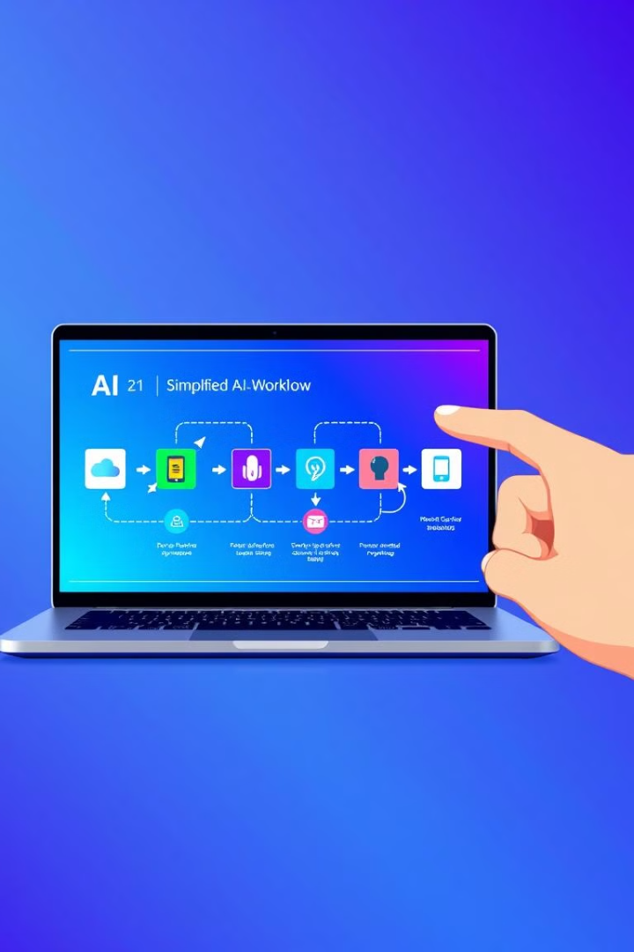
Automated Machine Learning (AutoML): Simplifying Complex Processes
1
Data Preparation
AutoML automates tasks like data cleaning and feature engineering.
2
Model Selection
It automatically selects the most appropriate ML model for a given task.
3
Hyperparameter Tuning
AutoML optimizes model parameters to improve performance.
4
Deployment
It simplifies the process of deploying ML models into production environments.

Slide 8




AI Ethics and Responsible Innovation
Transparency and Explainability
Privacy and Security
Protecting user data and ensuring privacy is paramount in AI development.
AI decisions should be transparent and explainable to build trust and accountability.
Accountability and Responsibility
Fairness and Bias
Clear guidelines and mechanisms are needed to address potential risks associated with AI.
AI systems should be developed and deployed in a fair and unbiased manner.
2
3
1
4

Slide 9

Future Predictions: AI Technology Trajectories
Advancements in NLP
1
Natural Language Processing (NLP) will continue to advance, enabling more natural and intuitive interactions with AI.
2
Growth of AI in Healthcare
AI will play a significant role in healthcare, from personalized medicine to early disease detection.
AI-Powered Automation
3
AI will automate various tasks, leading to increased efficiency and productivity in industries.
4
Ethical AI Regulations
Regulations will be put in place to ensure responsible and ethical development and deployment of AI.

Slide 10

Key Takeaways and Emerging Opportunities
AI and ML are transforming technology landscapes, creating new opportunities and challenges. Understanding the latest trends in these fields is crucial for individuals and organizations to navigate the evolving digital landscape.

